Slide 1
AI in Health
Introduction

Slide 2
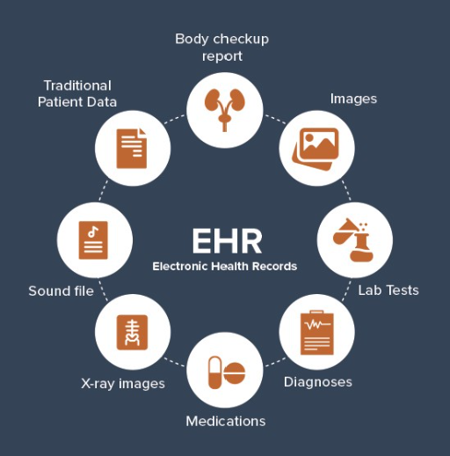


Goal of AI in Health: to Deliver High Quality Care
Quality Care is the evidence-based care that is based on sound scientific study identifying the best treatment possible.
Quality care is safe, effective, efficient, equitable, patient-centered, and timely

Slide 3
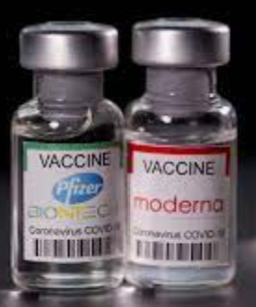
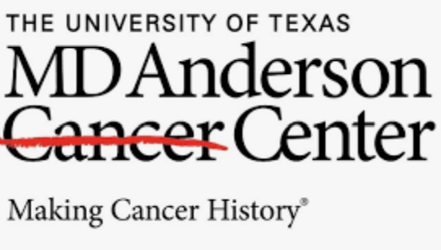
Excellence of US Healthcare
The leading healthcare research in the world, assembling the world ultra best and most dedicated medical researchers, labs, and universities
Owning the world finest and well equipped hospitals and facilities
Creating most of medical miracles

Slide 4
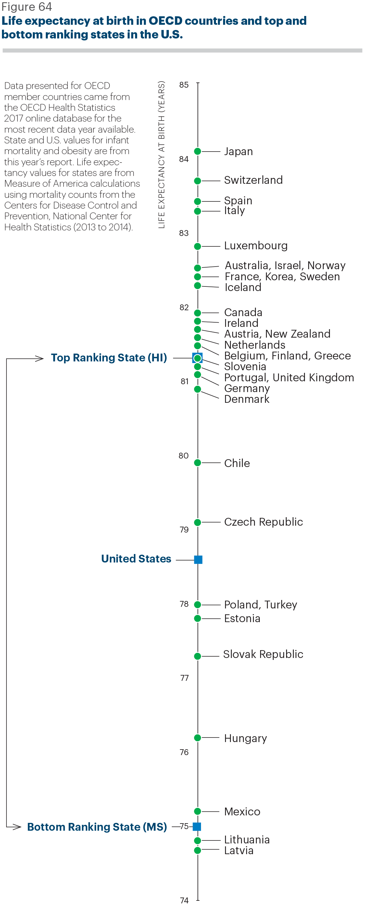
The reality of US Healthcare
The collapse of our healthcare system has been persistent and pervasive
Our healthcare spending ranks No. 1 in the world (16% of GDP), but the output of such spending is shocking [healthranking, 2017]:
For infant mortality rates, we are mediocre, worse than Slovenia, better than Chili.
For life expectancy: USA is ranked No.28 out 36 OECD countries

Slide 5

Medical Errors
More than 250,000 people in the United States die every year because of medical mistakes, making it the third leading cause of death after heart disease and cancer , 9.5% of total yearly hospitalizations – Feb 2018 [CNBC, 2018]
The number can go higher to 440,000 as human errors are often not reported in the death certificates
These mistakes are inherited in the fragmented and poorly designed healthcare system which leads to misuse, overuse, and underuse of healthcare.
80% of medical care solutions have not been scientifically tested
It takes 17 years for one medical scientific discovery being delivered to patients [Chasm 2001]

Slide 6
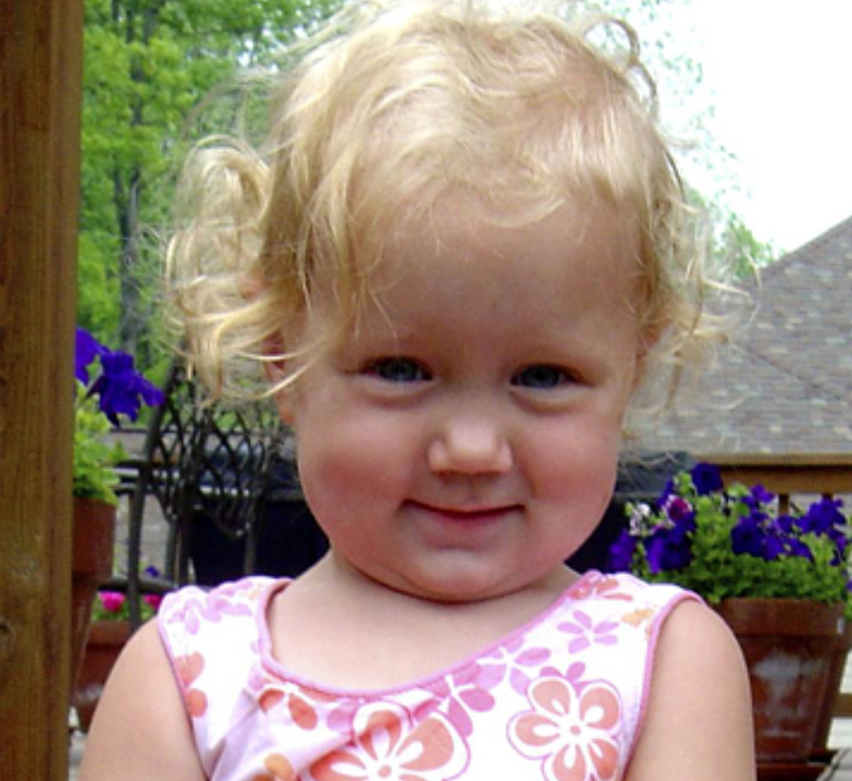
Case
Emily Jerry
Two years old died of human errors of pharmacy technicians who routinely compound patient’s IV medications. Emily was killed by an overdose of sodium chloride in her chemotherapy IV bag. – Emily Jerry Foundation
https://emilyjerryfoundation.org/

Slide 7
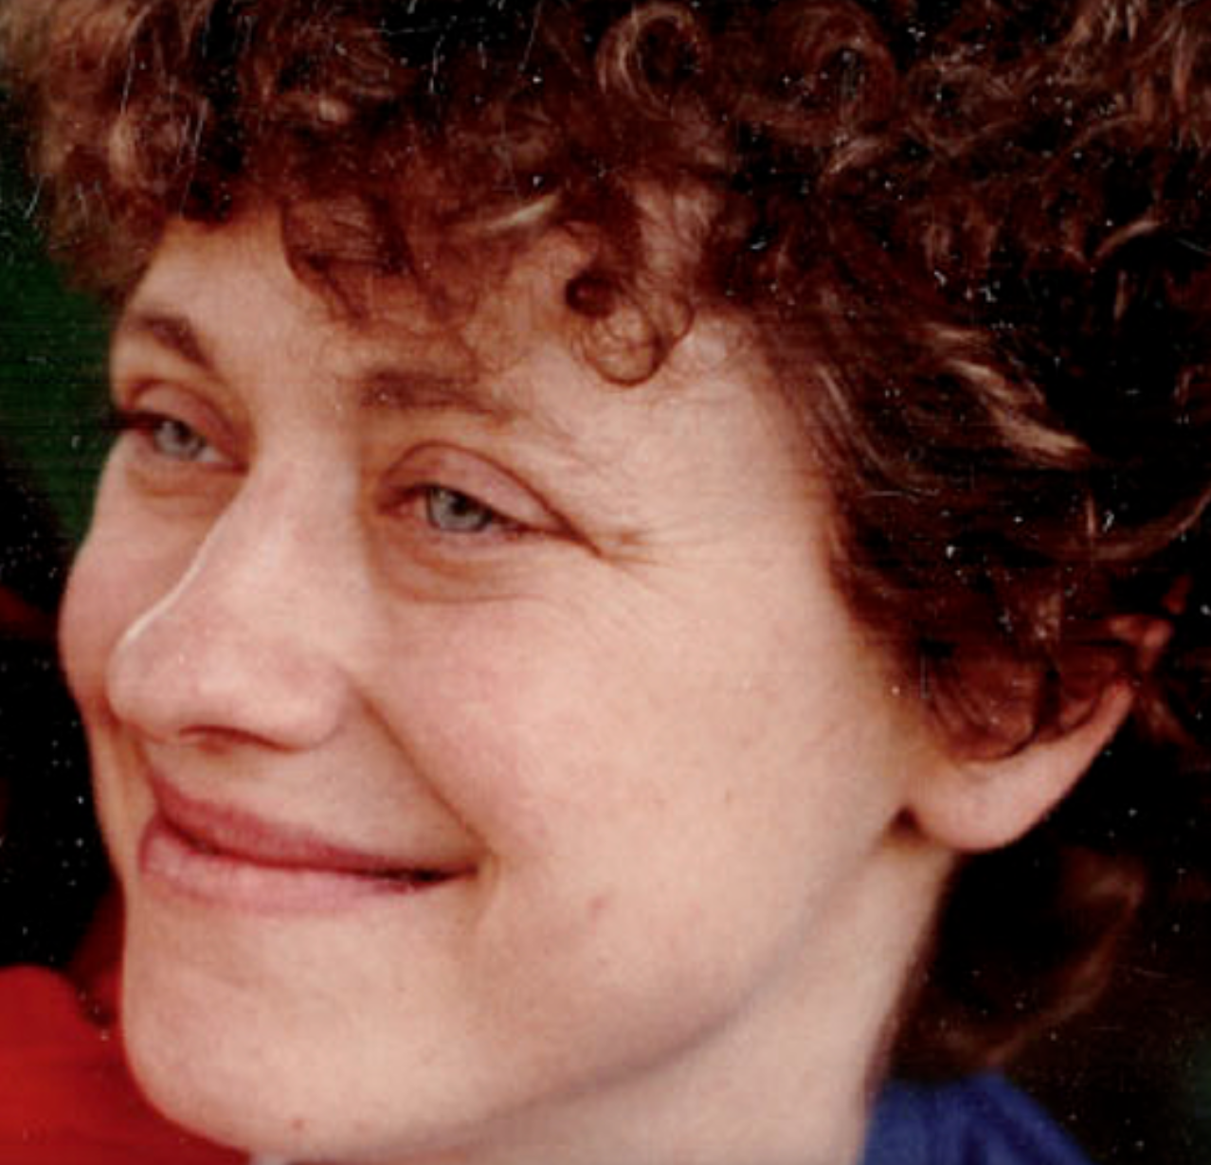
Betsy Lehman
In 1994, Betsy Lehman, a reporter of Boston Globe and mother of two young girls, was battling advanced stage of breast cancer. She was killed by the four times the intended dose of a powerful chemotherapy drug at Dana-Farber Hospital (the world premier cancer center). – Betsy Lehman Center
https://betsylehmancenterma.gov/

Slide 8
Jeanne Ellis
Radiologist mistreated her in 2016 who failed to identify obvious tumor in her X ray, lead to her death of two years later with the cancer advanced in her lung, kidney, and bone. Dr. Peter Clarke of Brigham and Women’s Hospital, who is the radiologist, does not have her EMR and medical history, and family member died of lung cancer before. [Boston 2014]
https://www.bostonglobe.com/metro/2014/06/29/overlooked-lung-cancer-results-million-verdict-against-radiologist/rbFZ4e94nIeH57r46ixVSL/story.html
A jury has awarded $16.7 million to the daughter of Jeanne Ellis

Slide 9
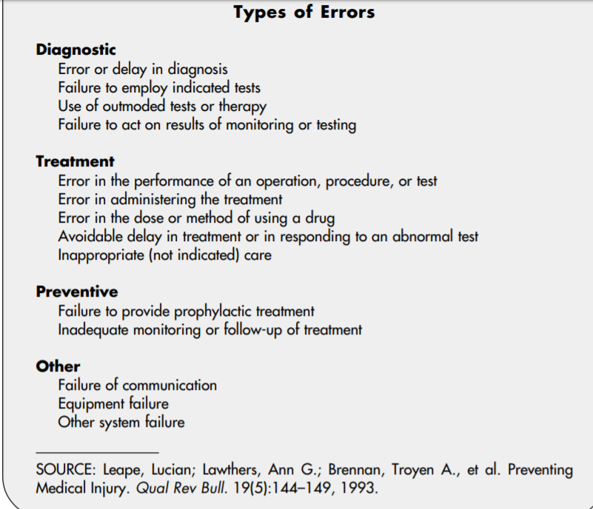

Slide 10
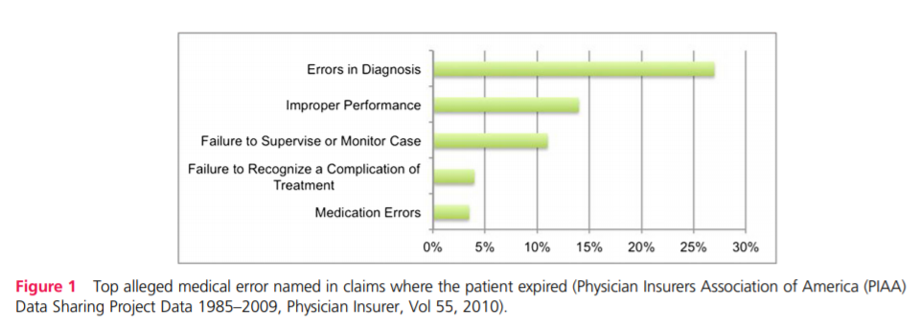
https://qualitysafety.bmj.com/content/qhc/22/Suppl_2/ii21.full.pdf

Slide 11

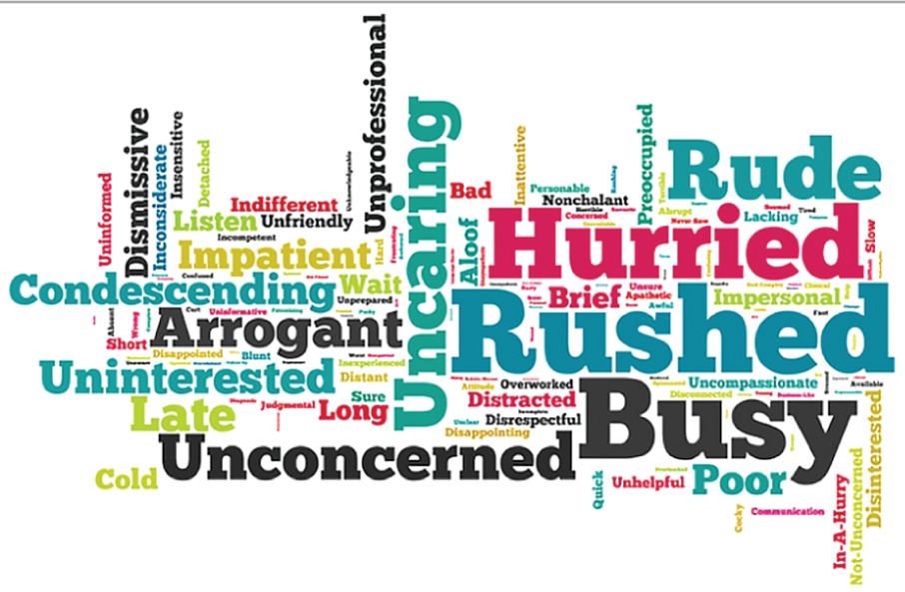
2 words about doctors from patients
Length of clinical visit:
US: 7mins (12mins for a new patient)
Korea: 2mins
B. Singletary et al. (2017). Patient perceptions about their physicians in 2 words: The good, the bad, and the ugly. JAMA Surg, 152(12), 1169-1170.

Slide 12
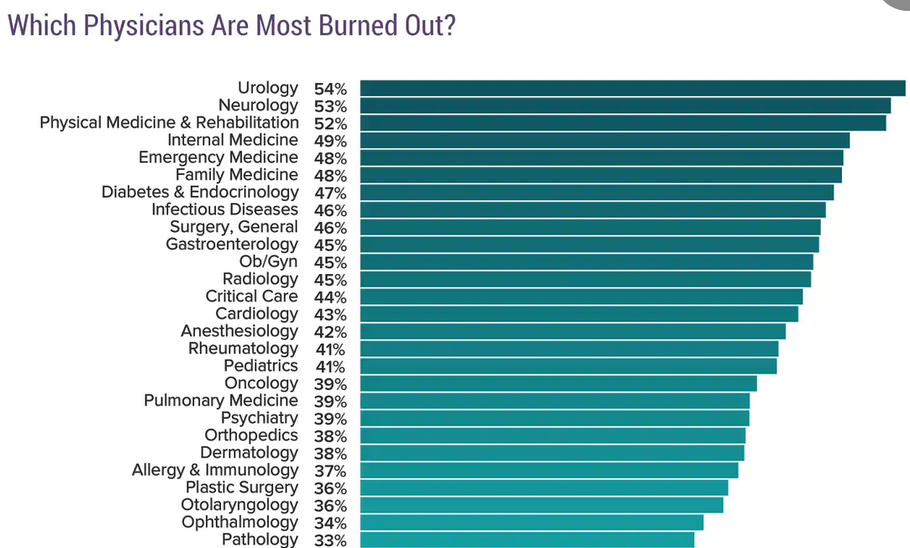
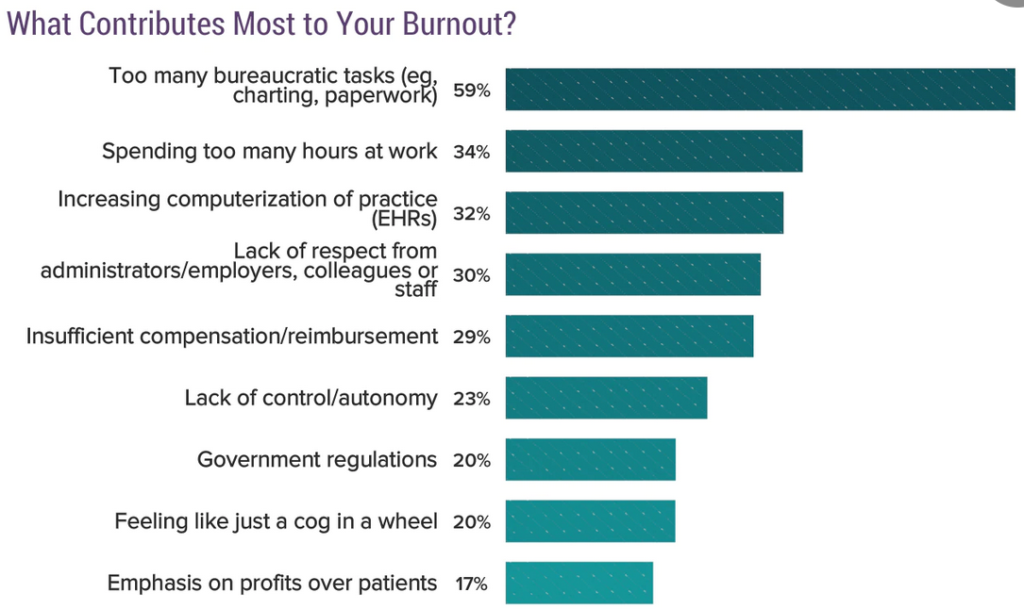
Physicians: burnout and depression
50% of doctors practicing in the US have symptoms of burnout, and there are hundreds of suicides per year.
https://www.medscape.com/slideshow/2019-lifestyle-burnout-depression-6011056#6

Slide 13
What went wrong
The delivery of healthcare:
a large gap/chasm in the quality and outcomes that health services being delivered. Unwarranted variation in medical treatment, cost, and outcomes suggests a substantial area for improvement and savings in our health care system.
Statistical findings show that "patients in the highest-spending regions of the country receive 60 percent more health services than those in the lowest-spending regions, yet this additional care is not associated with improved outcomes.
Studies show that individuals with diabetes should have blood lipids monitored regularly, yet patients in Chicago are 50% less likely to receive these tests than patients in Fort Lauderdale. A patient with heart disease in Bloomington, Indiana, is three times more likely to have bypass surgery than a similar patient in Albuquerque. In Miami, where medical services are abundant, Medicare pays more than twice as much per person per year as it does in Minneapolis, with no discernible difference in overall health or life expectancy

Slide 14
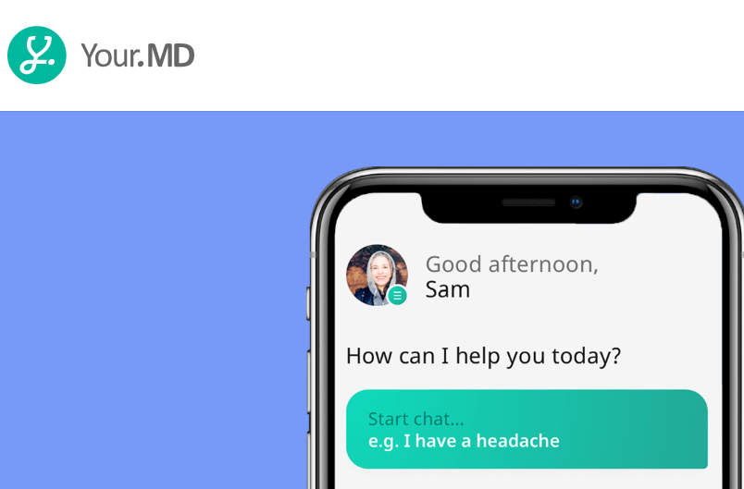

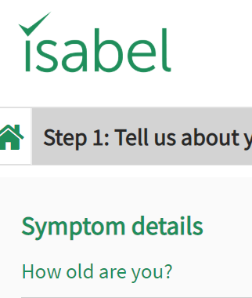

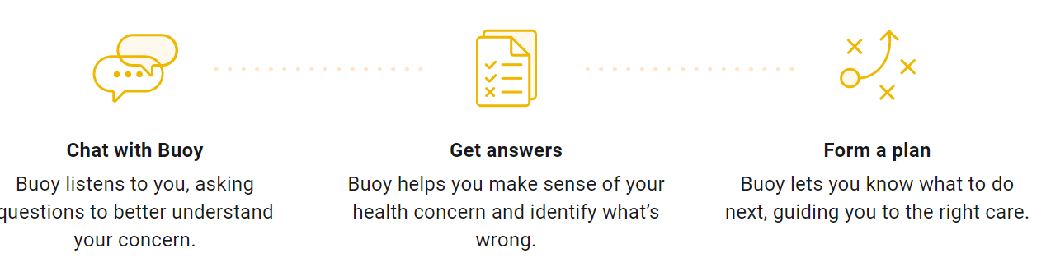
What patients will do
https://nhcps.com/online-symptom-checkers-evolution-of-self-diagnosis-is-upon-us/

Slide 15
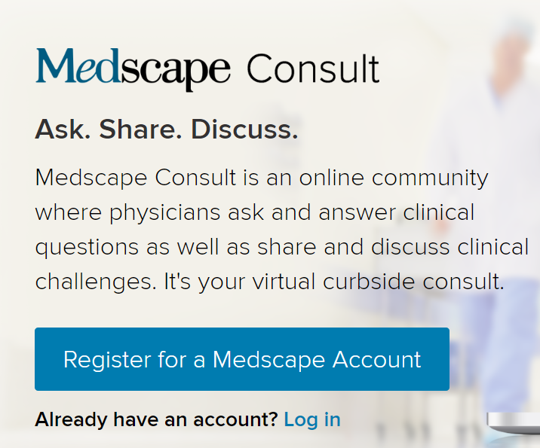


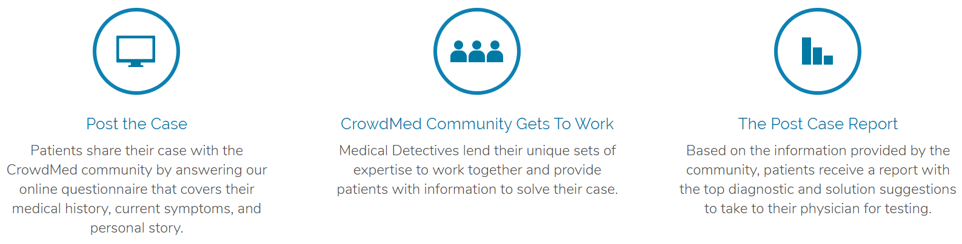
Second opinions for doctors
Doctors can crowdsource data with their peers to find help with diagnostic work.

Slide 16
Aim of U.S. Healthcare
Current U.S. healthcare needs the system wide changes -- RAND
Aim:
Providing safe, timely, effective, and affordable patient-centered care for everyone.
Making medical miracles accessible to all
Every doctor’s office is a center of clinical excellence
All patients should receive evidence-based care.
Americans should be able to count on receiving care that meets their needs and is based on the best scientific knowledge.

Slide 17
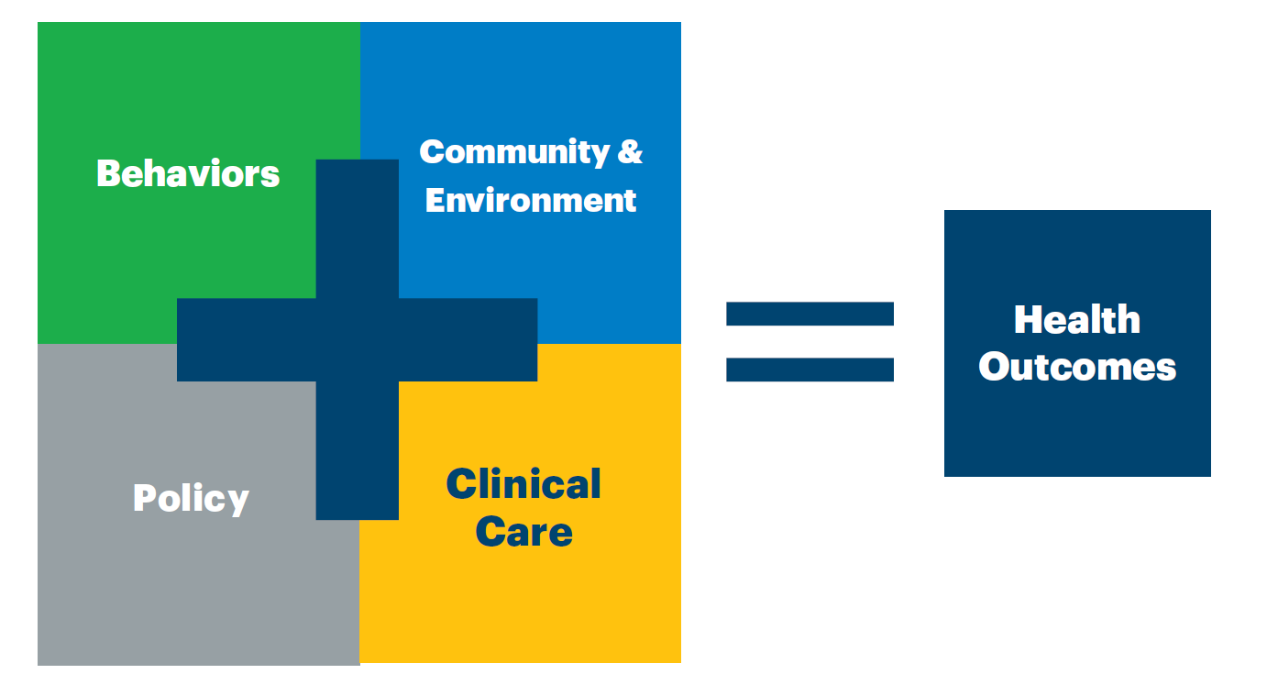
To achieve quality care

Slide 18
Evidence-Based Care (EBC)
Evidence-Base Care
Doctors should make diagnosis based on the medical history of the patient, treatments of similar patients, and related and latest scientific discoveries/literature
Patients should be able to access and understand the summarized report of their EMRs, and be informed with the latest scientific literature presented in a way that is easy to understand.
EBC enables a system that synthesizes TECHNOLOGY, SCIENCE, and PEOPLE to realize our highest aspirations for healthcare

Slide 19
Evidence-Based Care (EBC)
“No doctor – no matter how brilliant, dedicated and skilled – could possibly keep abreast of all the latest medical advances … to ask an individual practitioner to rely on his or her memory to store and retrieve all the facts relevant to patient care is like asking a travel agent to memorize airline schedules.” – [Chasm Report]
The three pillars of EBC are: Patient Values, Clinical Expertise and Relevant Research

Slide 20
AI in Medicine System Requirement: wish list
is a representation over time of health and health issues, treatment, preventive management, and health outcomes gathered from appropriate sources, including the patient, clinician, and laboratory and other tests;
supports clinical workflow and real-time decision making, and facilitates management of acute and chronic conditions, disease prevention and wellness; the review of overall health status; and the provision of patient education;
enables on-the-fly, actionable views of information that can be easily interpreted by clinicians as well as the patient and caregiver;
facilitates use of data to support registries, research, quality improvement, education, risk assessment, team function, value-based care, billing, compliance, and population health;
allows for visualization of meaningful and actionable cost and coverage rules to reduce administrative burden and facilitate shared decision making, thus enabling efficient and effective health care delivery;
has a data structure that allows for the capture of the lifelong patient record, including integration of information from all members of the clinical care team, the patient, and caregivers;
connects to all relevant health applications and devices, delivered through audio, video, data, imaging, and other approaches;
includes relevant genetic, behavioral, social, and environmental determinants of health; and
is interoperable and secure, and has the ability to support seamless information flows when desired and/or appropriate, regardless of its storage location.[NAM, 2018]

Slide 21
Now what!
Future is already here, it is not just evenly distributed – William Gibson
For us: Future is already here, it is not just evenly delivered.
AI powered automated integration is the key
Integrating patient encounters, lab results, vitals, and more
Integrating and summarizing cohorts with similar treatments, outcomes
Integrating and summarizing scientific outcomes to educate patients
Recommending related scientific achievements to doctors

Slide 22
References
[CNBC 2018]: https://www.cnbc.com/2018/02/22/medical-errors-third-leading-cause-of-death-in-america.html
[NAM 2018]: Horvath, K., P. Sengstack, F. Opelka, A. B. Kitts, P. Basch, D. Hoyt, A. Ommaya, P. Cipriano, K. Kawamoto, H. L. Paz, J. M. Overhage. 2018. A vision for a person-centered health information system. NAM Perspectives. Discussion Paper, National Academy of Medicine, Washington, DC. https://doi.org/10.31478/201810a. https://nam.edu/a-vision-for-a-person-centered-health-information-system/
[Healthranking 2018]: https://www.americashealthrankings.org/learn/reports/2018-annual-report/findings-international-comparison
[Chasm 2001]: http://www.nationalacademies.org/hmd/~/media/Files/Report%20Files/2001/Crossing-the-Quality-Chasm/Quality%20Chasm%202001%20%20report%20brief.pdf

